Slide 1

BLACKTECH CAPSTONE
OLUTOLA ADUNOLUWA

Slide 2

Hotel Bookings

Slide 3





Slide 9
Hotel Case Study: Agenda
Entity Relationship Diagram (ERD)
Recommendations
ERD Description
Data Quality Recommendations
2
4
1
3
Issues
Dashboards
Data Quality Issues
Hotel Bookings Dashboard
Food Order Dashboard
Your logo
2

Slide 4



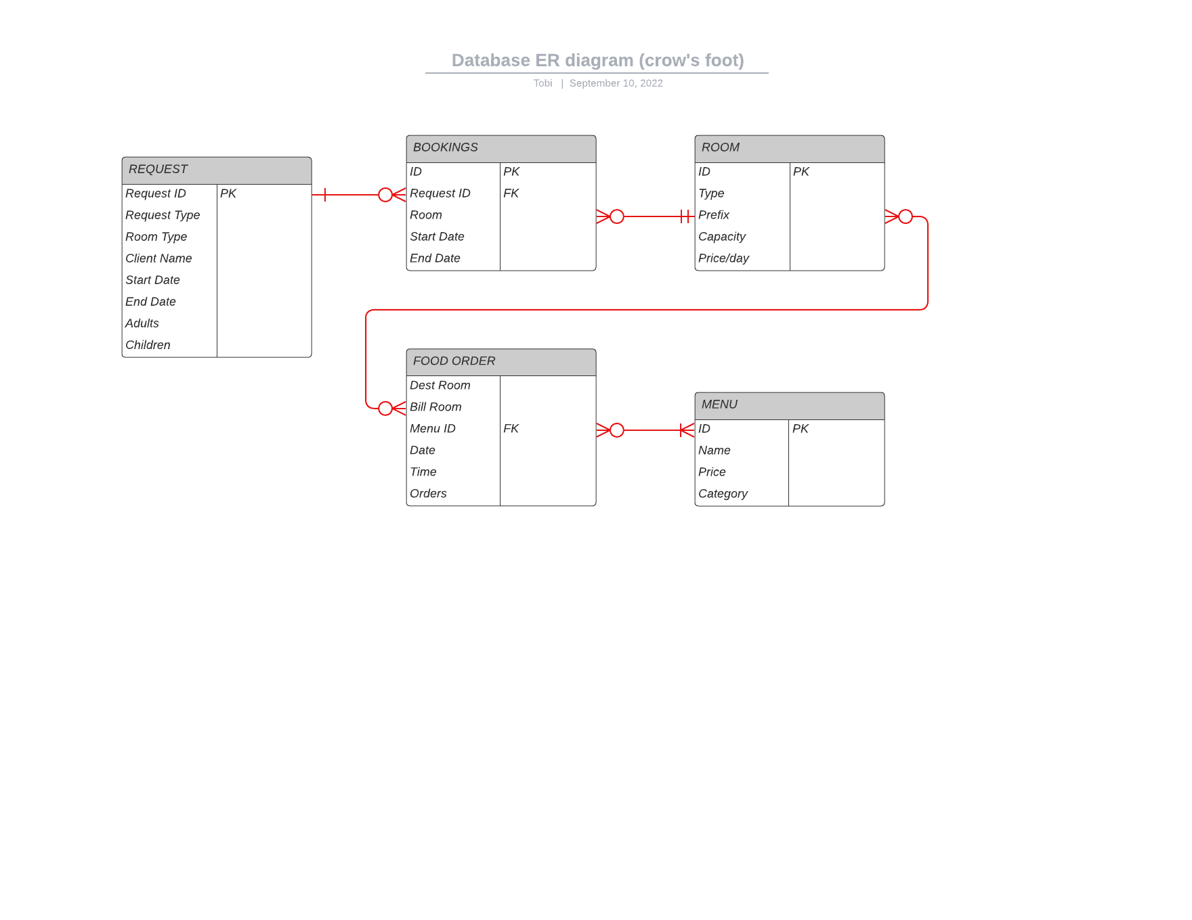
Entity Relationship Diagram (ERD)
3

Slide 5






Slide 7
ERD Description
Request Table: Request table contains information about client requests, including the room type, number of occupants and request dates. The request ID serves as the unique identifier (PK) which is referenced in other tables. A one to many relationship exists between the Request and Booking tables
Booking Table: This table contains information about booked rooms, the booked dates. It has a unique identifier - Booking ID - and references the Request ID as a foreign key. A many to one relationship exists between the Booking and Room tables
Room Table: This table contains the capacity and pricing information of each room type and has a Room ID unique identifier (PK). A one to many relationship exists between the Room and Booking tables.
Menu Table: This table lists the names and prices of each menu item uniquely identified with the Menu ID (PK). A many to many relationship exists between the Food Order and Menu tables
Food Order: This table lists information about the date and time of food ordered and references the Menu ID as a foreign key
4

Slide 6
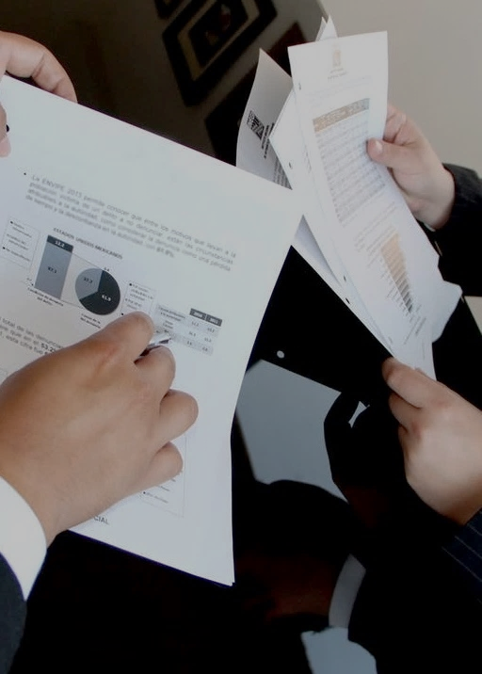
Hotel Bookings: Summary
Data was imported and cleaned for analysis using SQL and visualized using Power BI
Holiday had the highest amount of bookings with 3,441 bookings and generated the largest highest revenue of $1.59M
Normal rooms had the highest number of bookings with about 3.3k bookings and generated the highest hotel revenue of $1.22M
$51,670 was lost due to 281 requests that didn’t follow through.
Normal rooms had the highest amount of lost hotel revenue - $15,440 - due to failed requests
Steak ‘N’ Stuff generated the highest food revenue and French breakfast was the most ordered at 600 orders
Large conference rooms generated the highest food revenue and the ordered the most amount of food
Dinners had the largest amount of orders monthly with about 2727 orders.
5

Slide 7

Slide 7
Data Quality: Issues
Wrong Format: Inconsistent time format in Food Orders table i.e. 24hr format and 12hr format
Wrong Values: Wrong year values were entered in booking start and end dates during data entry
Redundant Values: the categorical data, vacation is a synonym for holiday in the request type column of the Request table
Redundant Field: The “Room ID” primary key is not referenced in other tables.
No “Food Order” table primary key
Inconsistent attribute names in different tables
6

Slide 8

Slide 7
Data Quality: Recommendations
Investment in database management systems like Azure or Oracle for easy data storage, manipulation and analysis
Validation for request type, time and booking date columns should be established for accurate data entry
Use of “Room ID” primary key in “Request” and “Food Order” tables to facilitate easy retrieval of room data
Addition of “number of rooms” column in “Request” table to easily calculate capacity limits
Creation of “Client” table to store client information, reward frequent customers, and for targeted ads.
A separate column for title should be added to eliminate issues with searching client names.
7

Slide 9
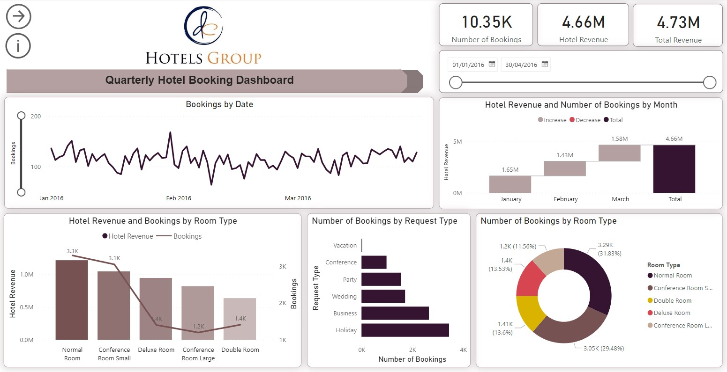
8

Slide 10
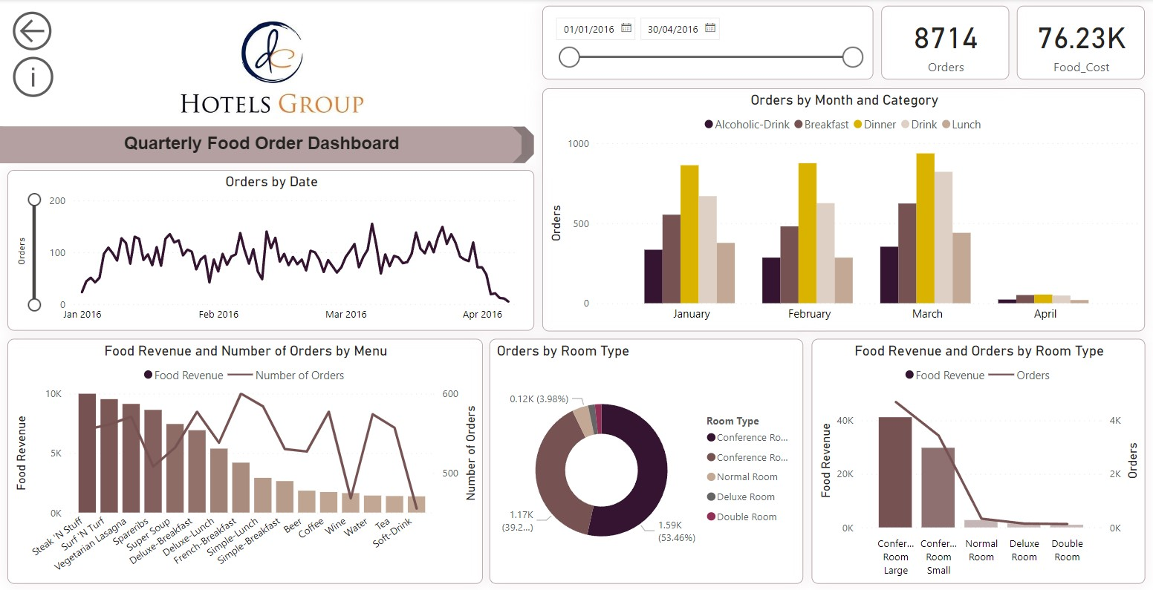
9

Slide 11
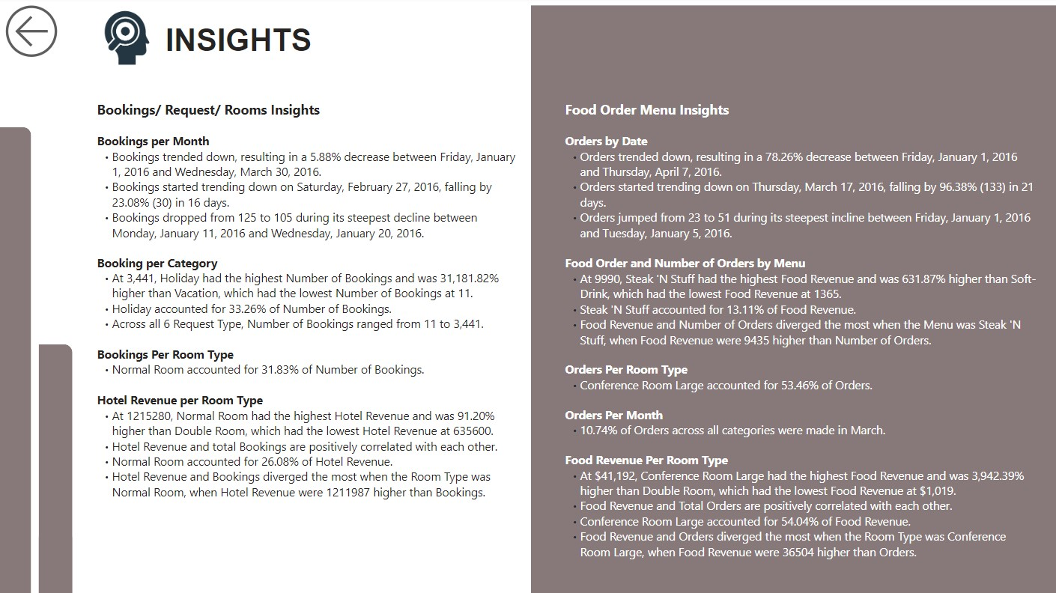
10

Slide 12

Slide 1
Thank You

Slide 13

Revenue Lost per Room Type

